Slide 1

Team 496

Slide 2
Our Team
Notes:
Zeff

Slide 3
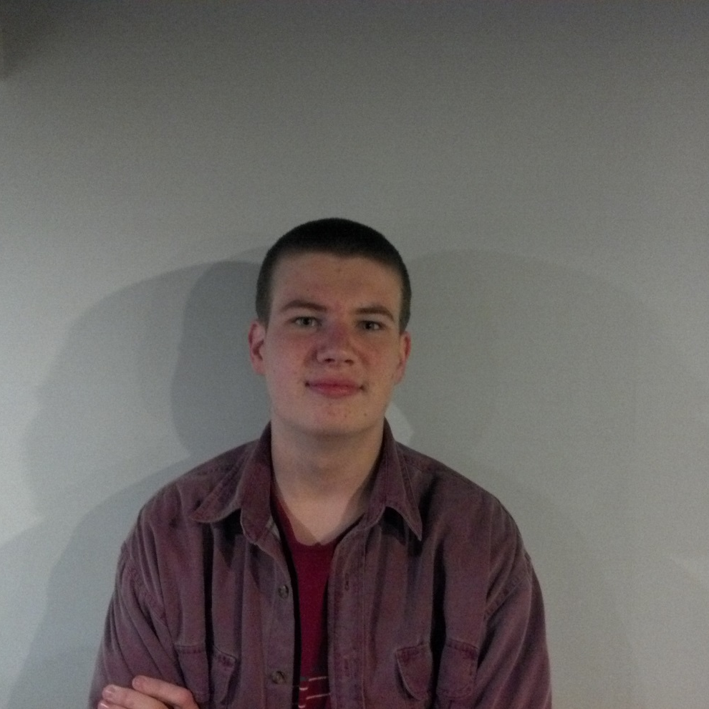

James Lutz
Lead Technical Engineer

Slide 4
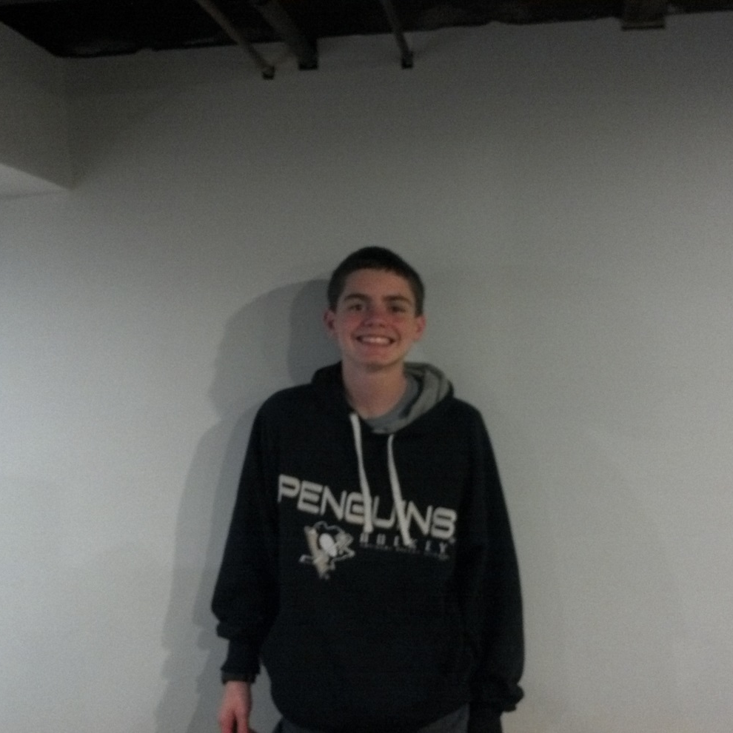

Jack Giebel
Assistant Technical Engineer and Android Advocate

Slide 5
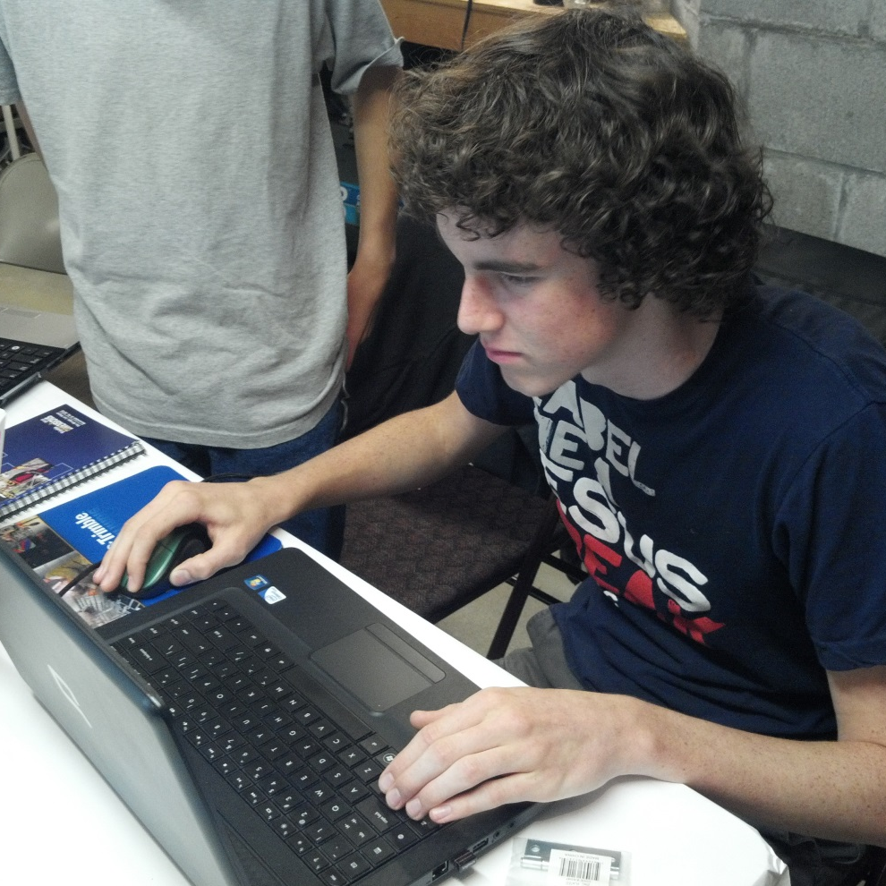

Drew Beck
Computer Aided Design Engineer

Slide 6

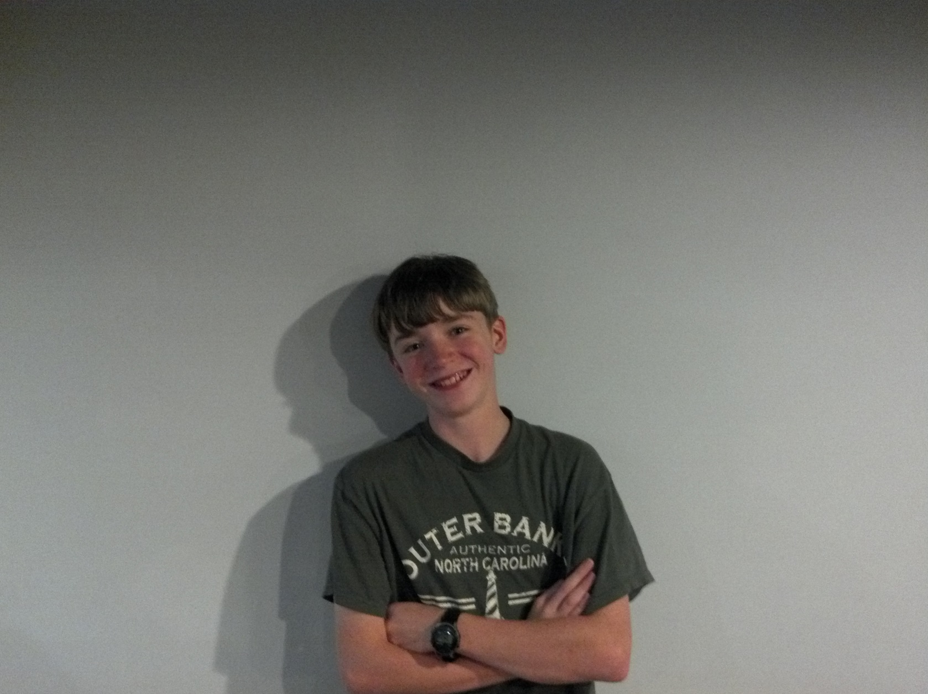
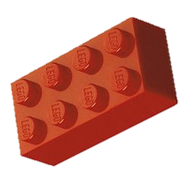

Zeff Pagano
Assistant Programmer and Apple Advocate
Micah Beideman
Robot Designer

Slide 7
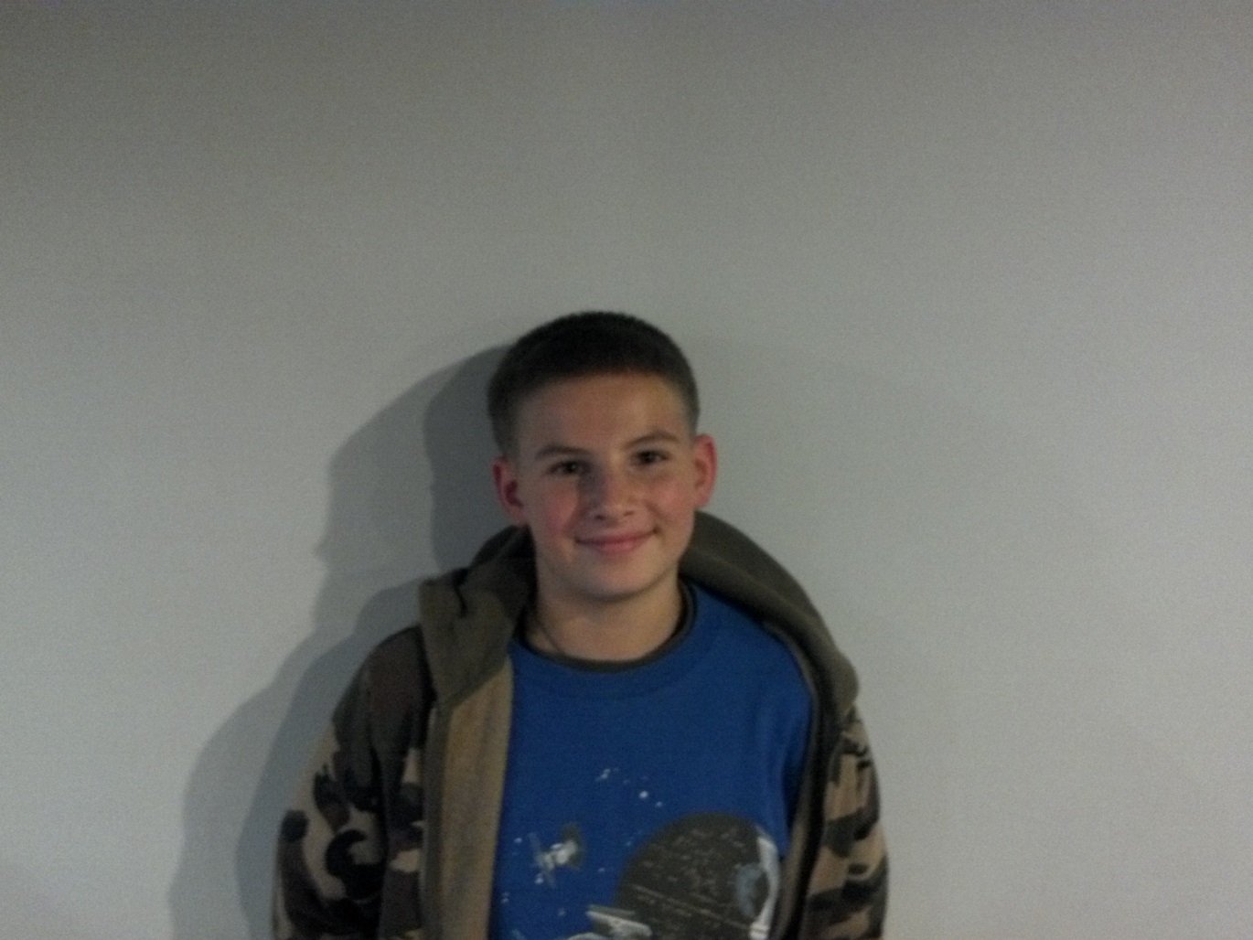
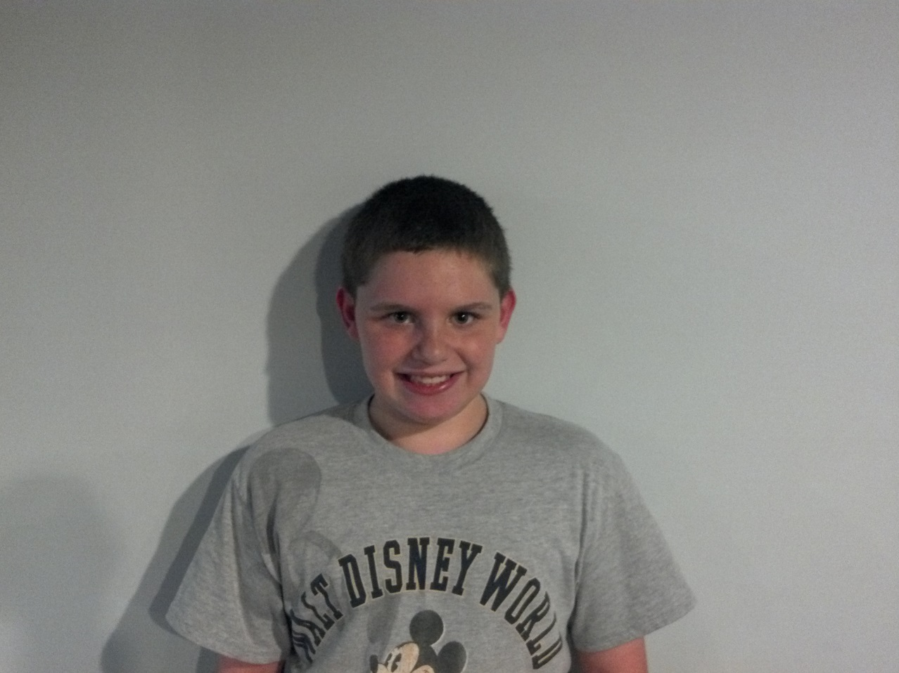

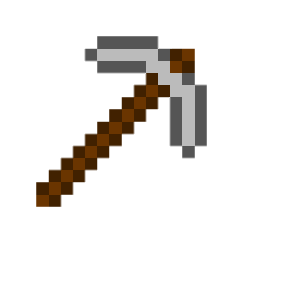
Jacob Lutz
Odds and Ends Guy
Scott Giebel
Assistant Odds and Ends Guy

Slide 8
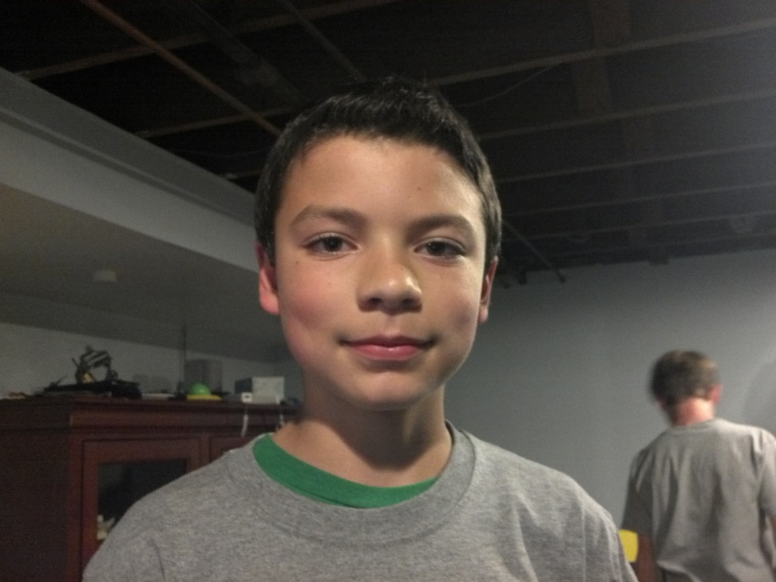


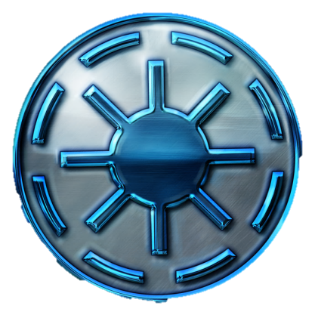
Jacob Evans
Builder
Daniel Evans
Builder

Slide 9
Age Demographics
Notes:
Zeff

Slide 10
Budget
Budget
Fundraiser | + $93
T-Shirts | - $90
Remaining | $3
Notes:
Zeff- we sold 372

Slide 11
Robot Design

Slide 12
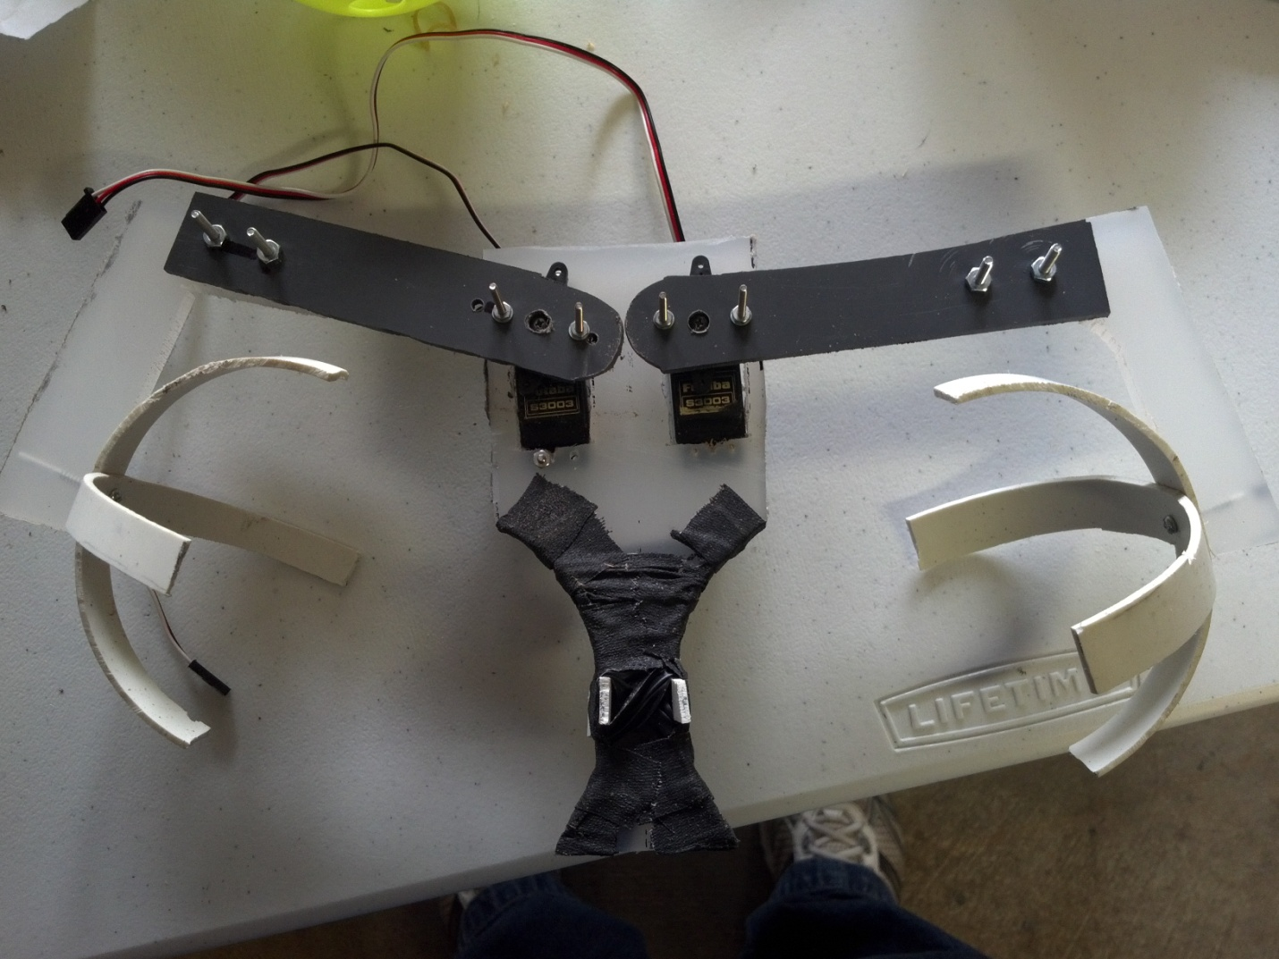
Grabbing the cargo
Notes:
Micah

Slide 13
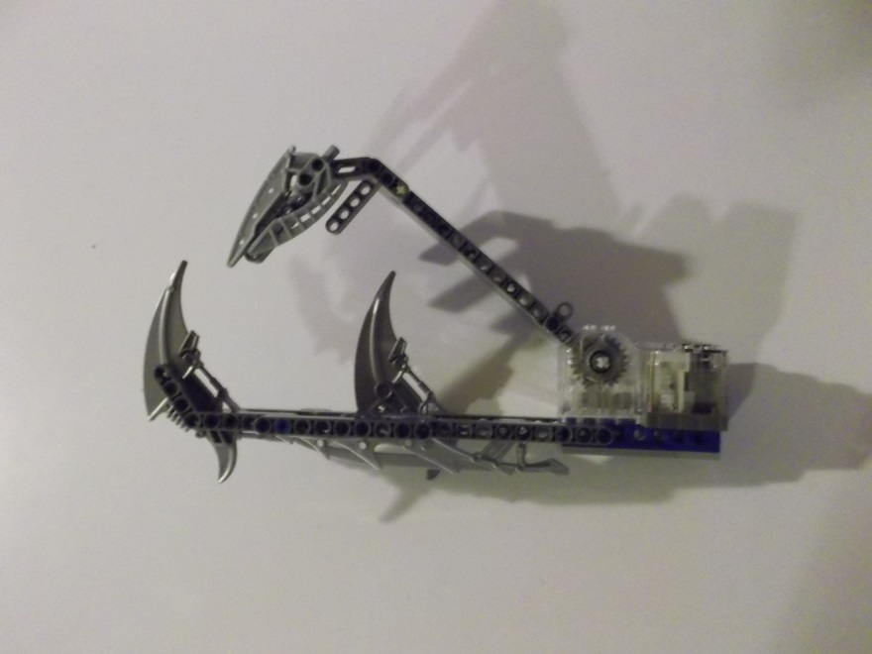
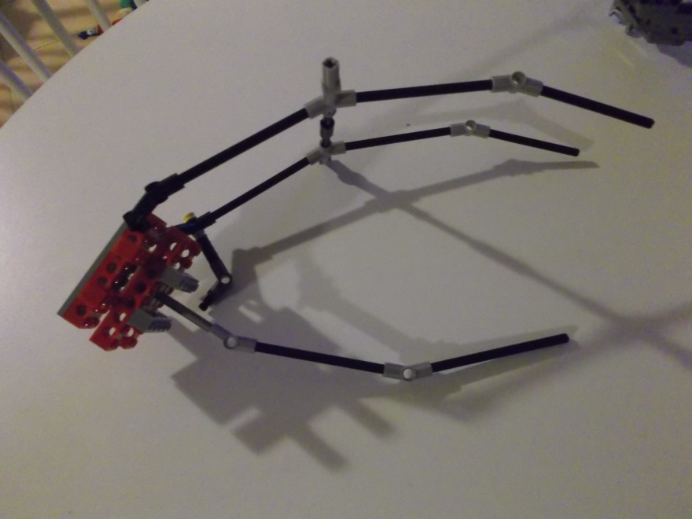
Claw Prototypes

Slide 14
Our innovative gripper allows us to transport a large amount of cargo every trip into space, twice as much as the competition.
This gripper was made using PVC and Plexiglas, making it sturdy and light.
By grabbing the cargo instead of scooping it, we reduce the risk of knocking it off and ruining the mission.

Slide 15
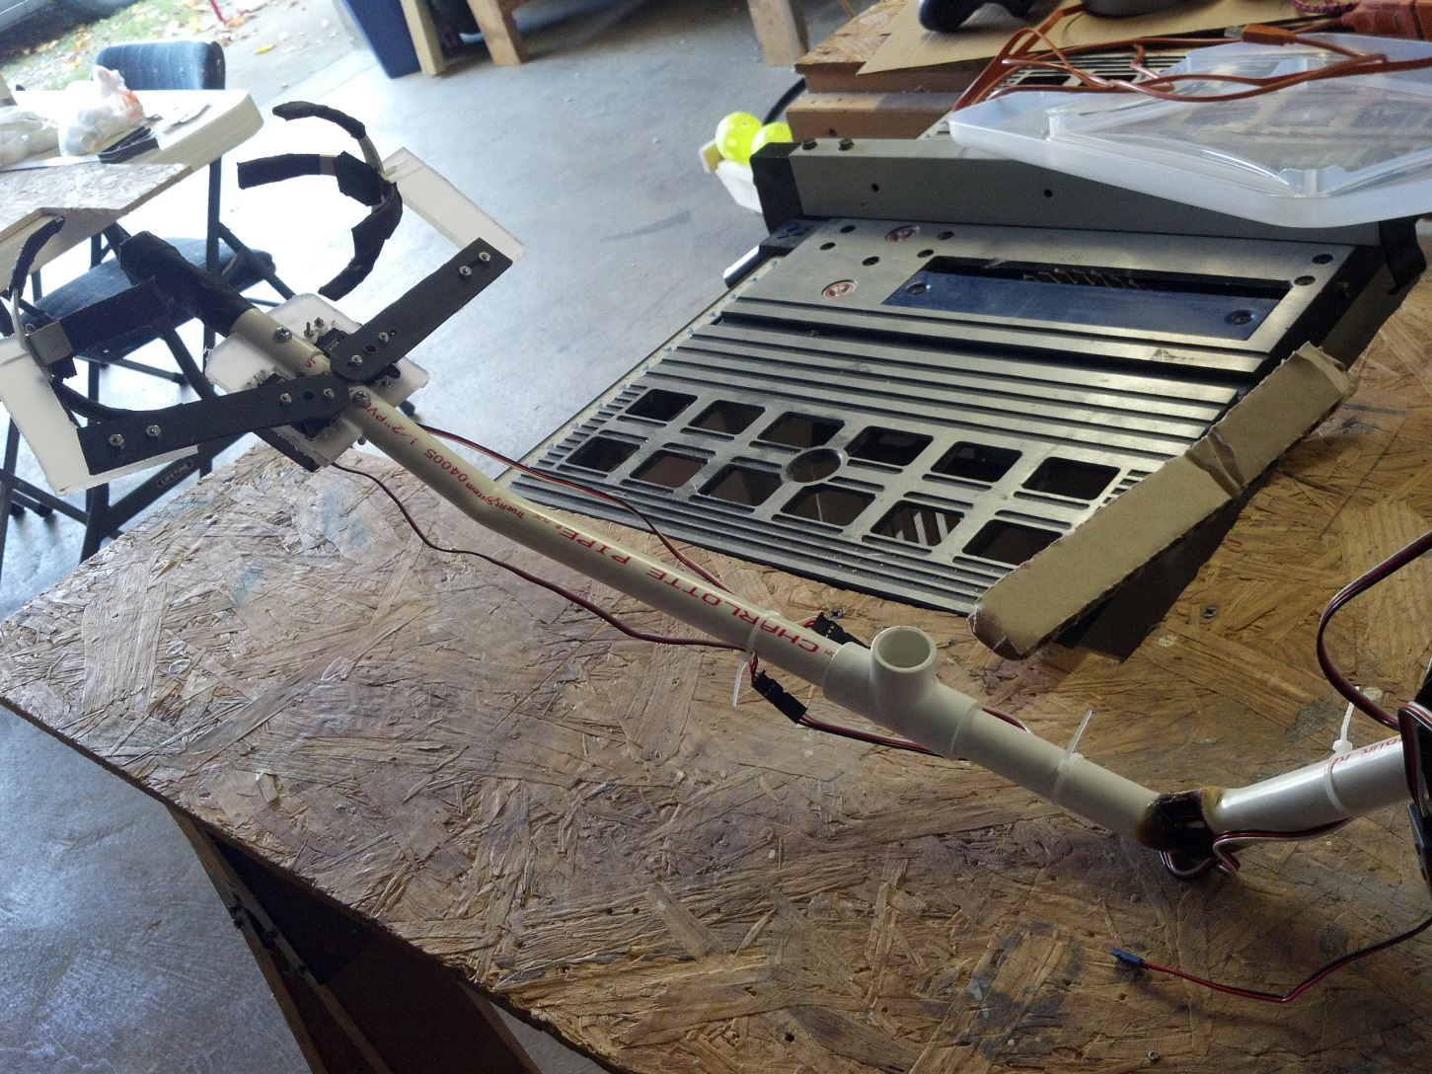
The Arm
Notes:
Micah

Slide 16
Our state-of-the-art arm system allows for the gripper to be easily and accurately deployed into to secure the cargo.
The arm is designed to reach above and behind the robot in order to deliver the cargo properly.
This arm is designed to do carry one type of cargo well, rather than a many types of cargo poorly like the competition does.

Slide 17
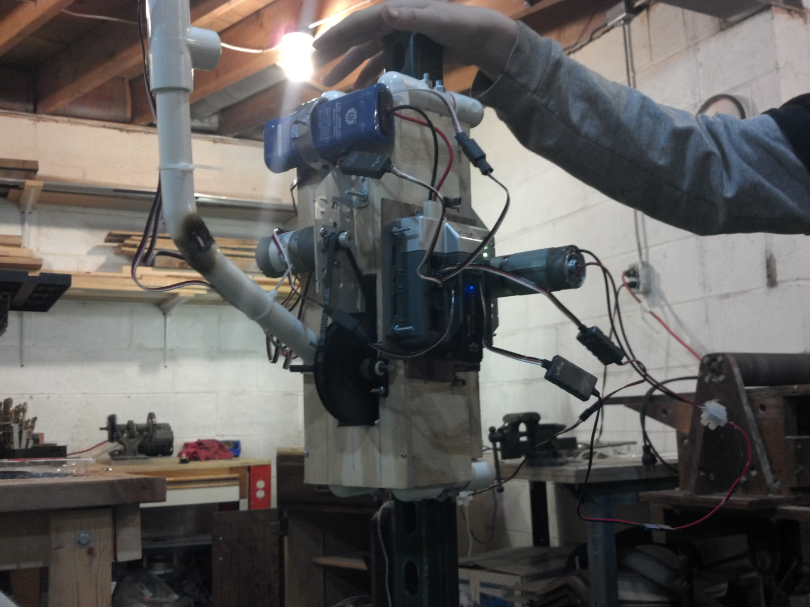
The Body
Notes:
Tanner

Slide 18
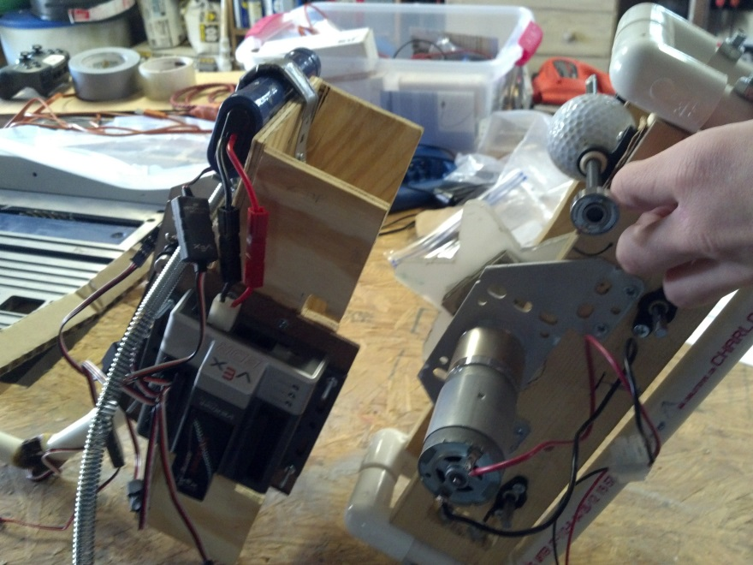
Our ground-breaking light-weight body system allows for easy attachment and removal from the pole.
This system also allows for easy access to the electronic systems.

Slide 19
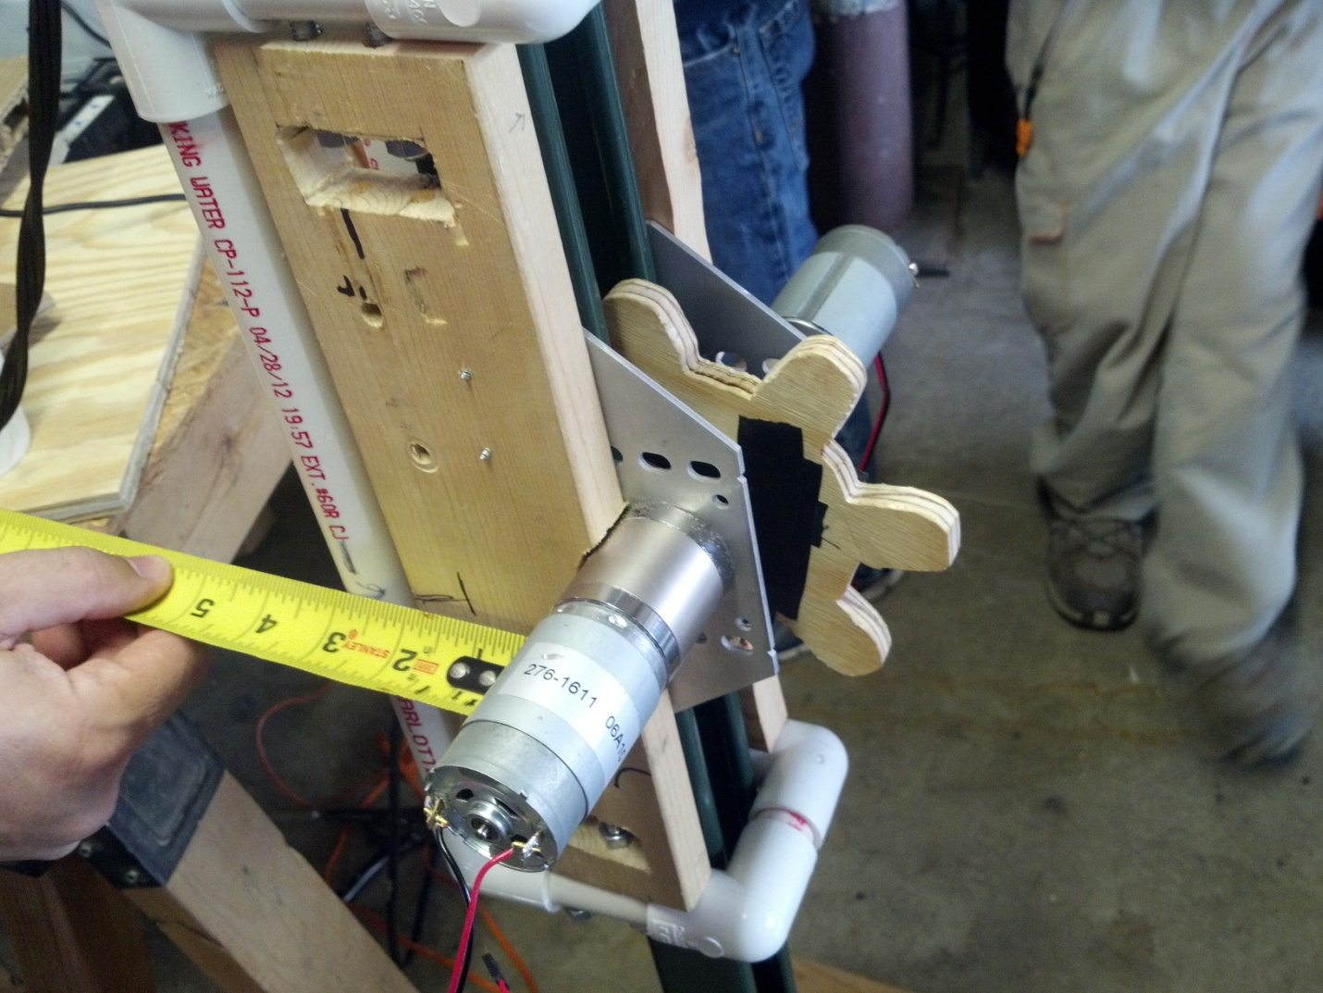
Climbing
Notes:
Tanner

Slide 20
In order to climb, we developed a powerful gear system using dual motor technology. This allows us to move up and down quickly and smoothly.
This gear system was carefully manufactured in order to provide the stability needed

Slide 21
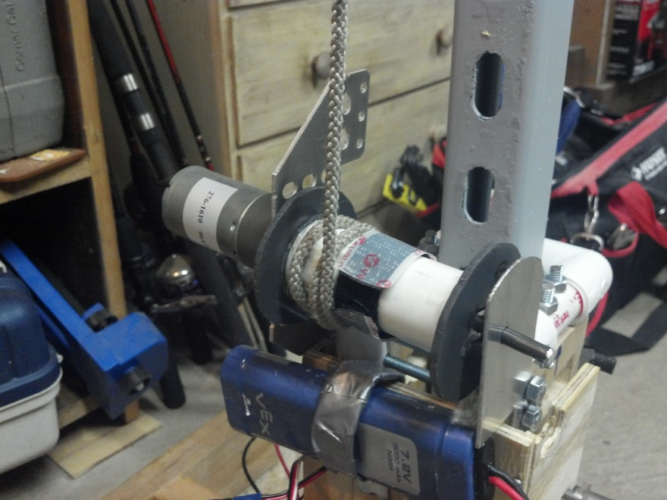
Climb Assist Mechanism
This precision system allows us to keep the robot moving in the event of the main gear stalling.

Slide 22
Safety Features
Our robot features advanced arm tracking to prevent cargo loss.
The array of advanced sensors our robot features allows us to prevent crashing.
Our Safety notification light system will let you know when the robot is active, so you can stay back
Notes:
Tanner

Slide 23
Use Of Available Technology

Slide 24
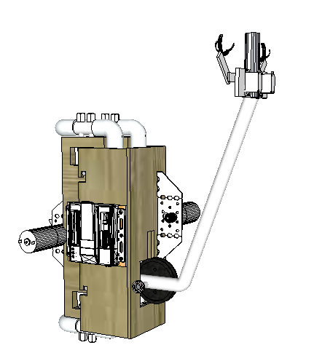
Computer Aided Design
This CAD design is an accurate computerized model of our robot.
Used for early testing and designing of parts, we were able to see what the components for the robot would look like before building them, and to give us an idea of the functionality of each component.
Notes:
Drew

Slide 25
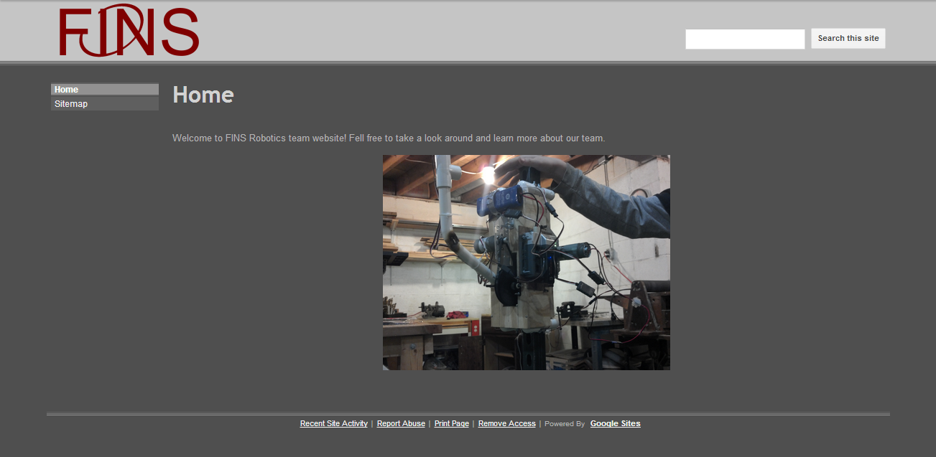
Website
Notes:
Jack

Slide 26
We created a company website in order to provide the community with information about our company.
This site also allows us to get news about our team out quickly and easily.

Slide 27
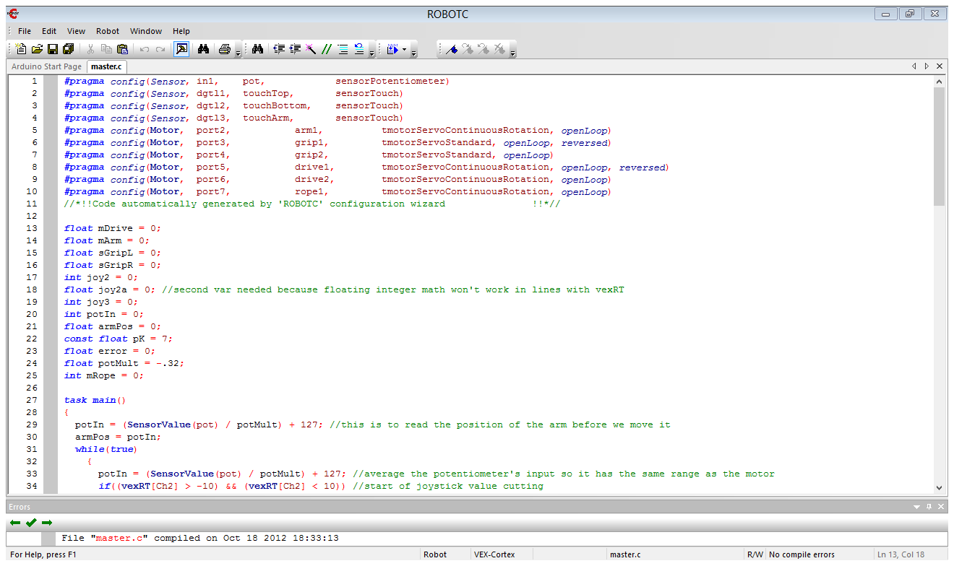
Software Features
Notes:
James

Slide 28
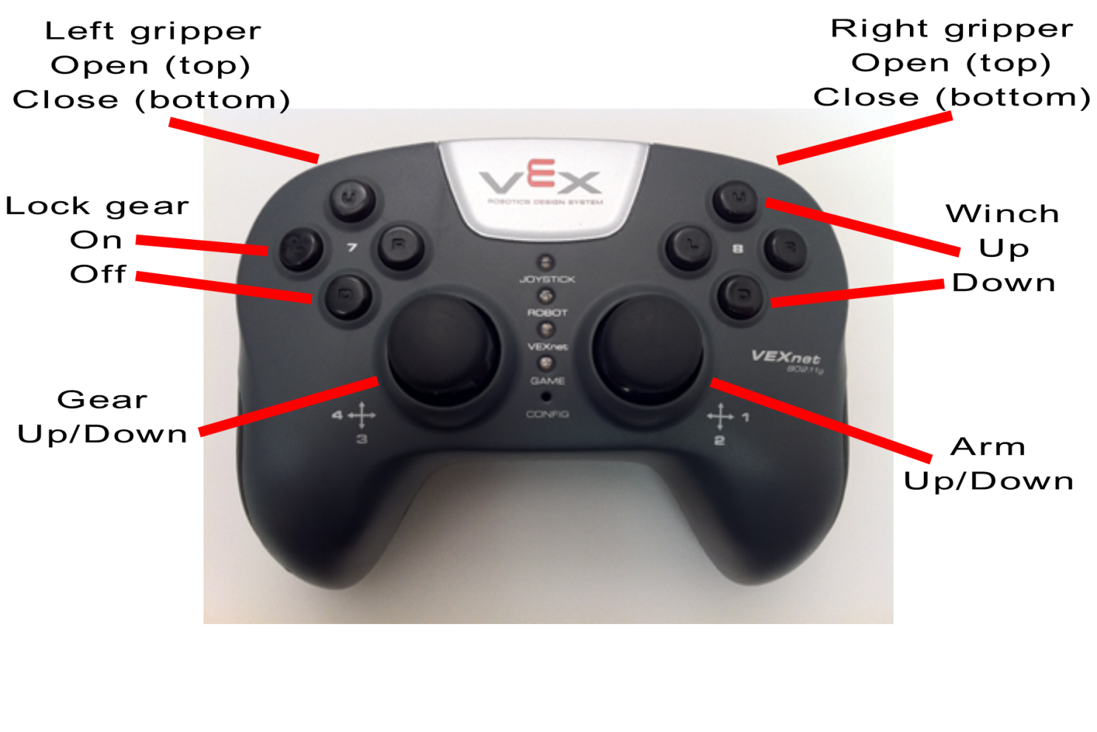
Easy Joystick Layout
Notes:
James

Slide 29
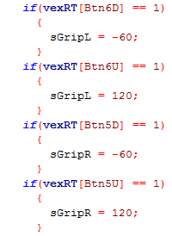
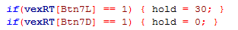
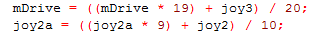
Simple and easy to use gripper servo control
Toggle-able climbing motor brake, prevents drifting
Exponential averaging, no jerky movements

Slide 30
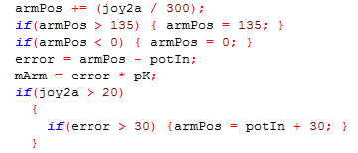
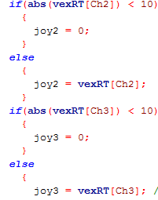
Use of potentiometer and proportional loop to keep the arm where we want it
Joystick input cutting, so an un-calibrated joystick won't strain the motors

